Slide 1
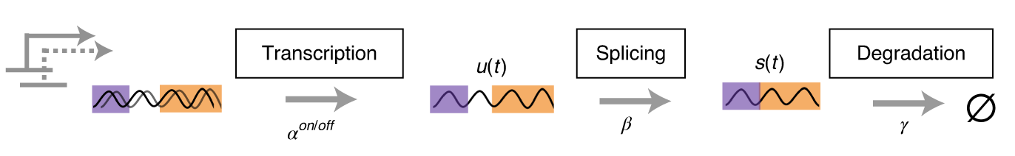

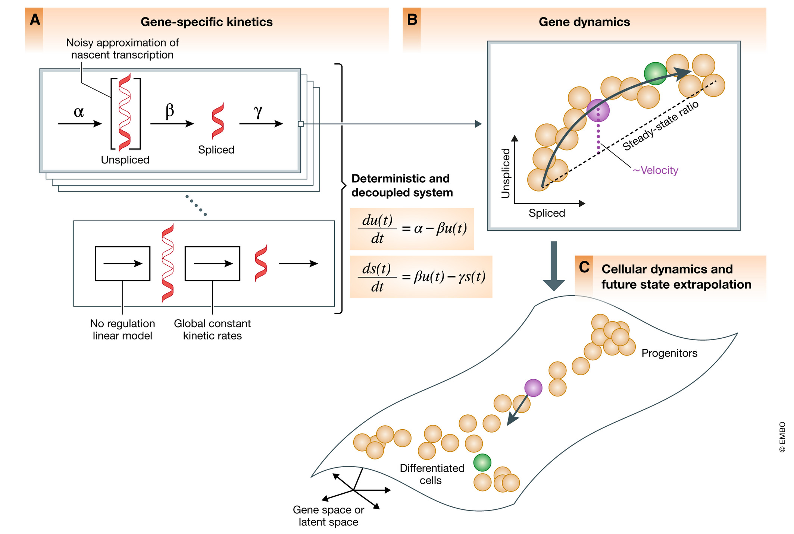

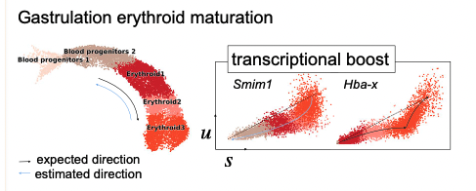
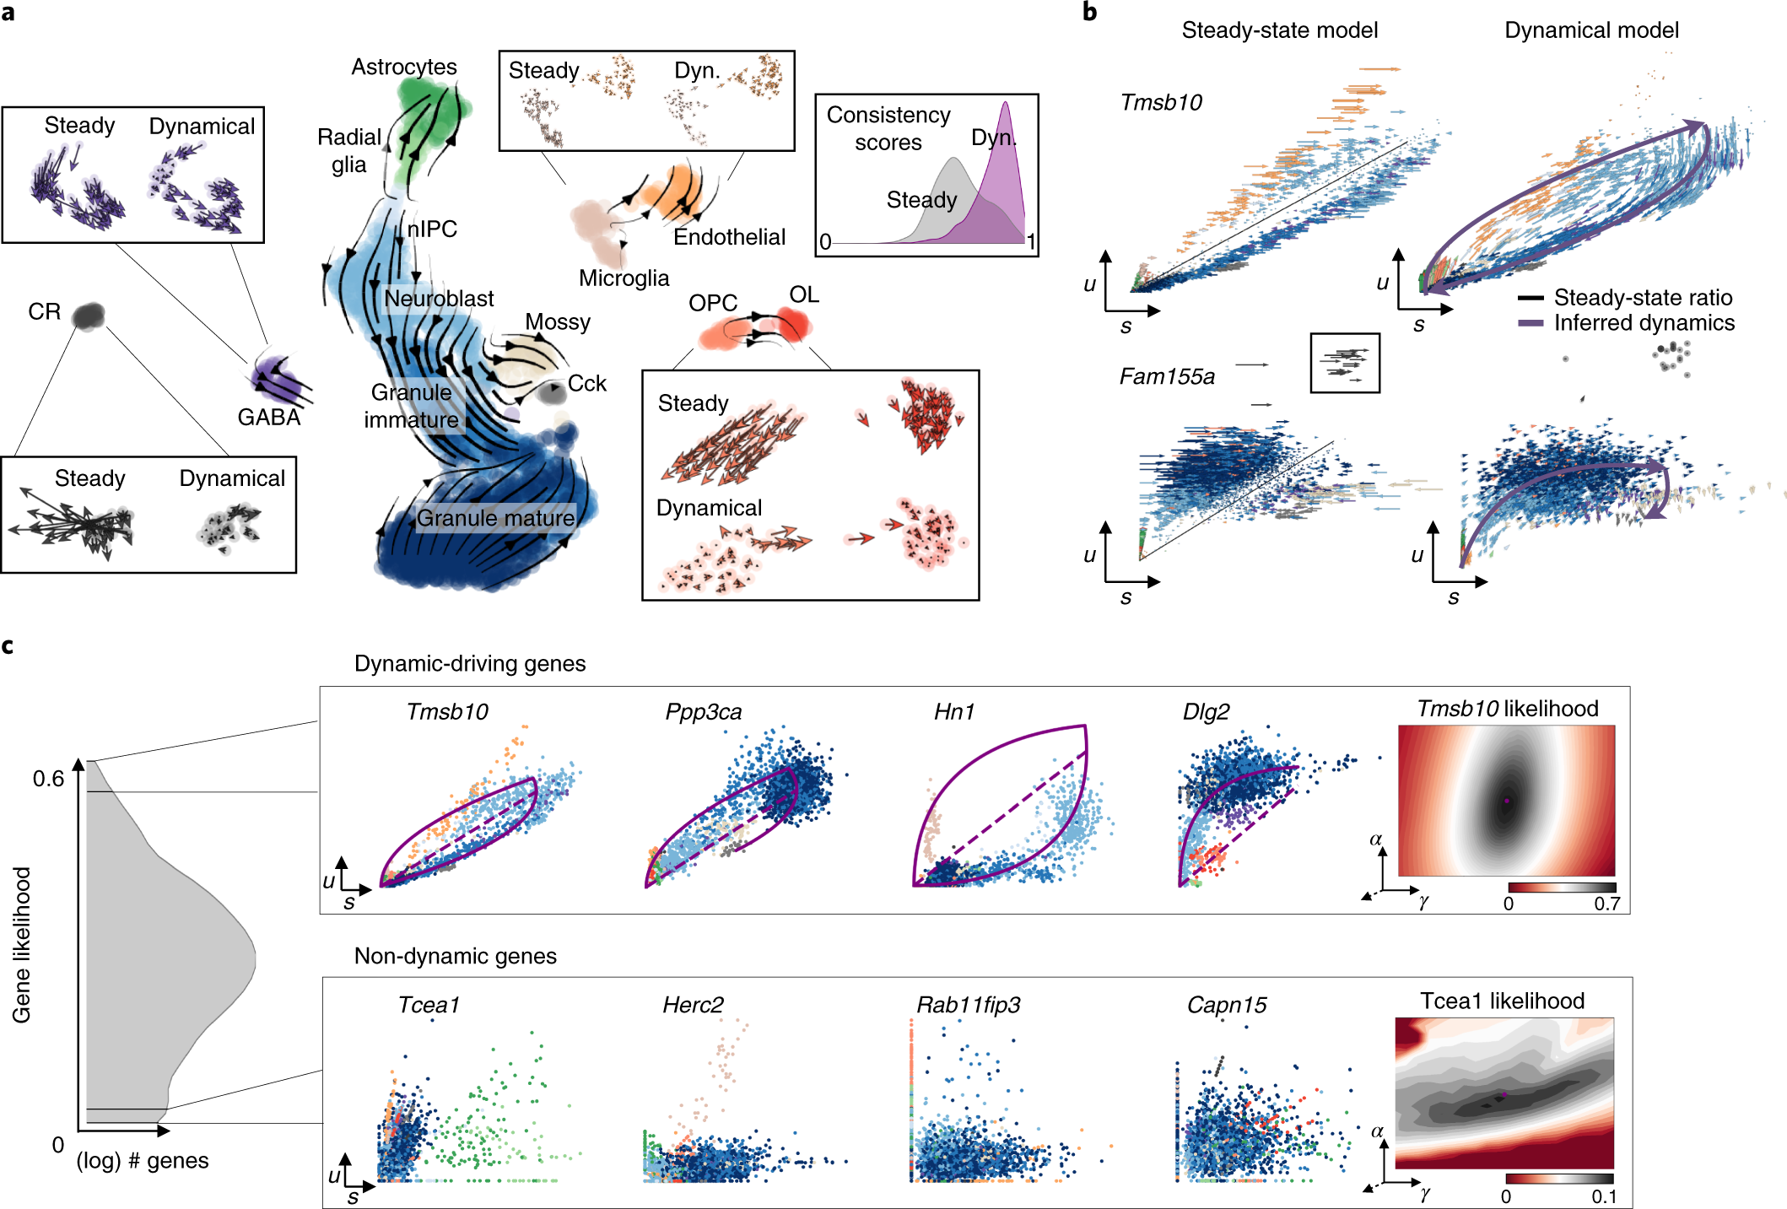

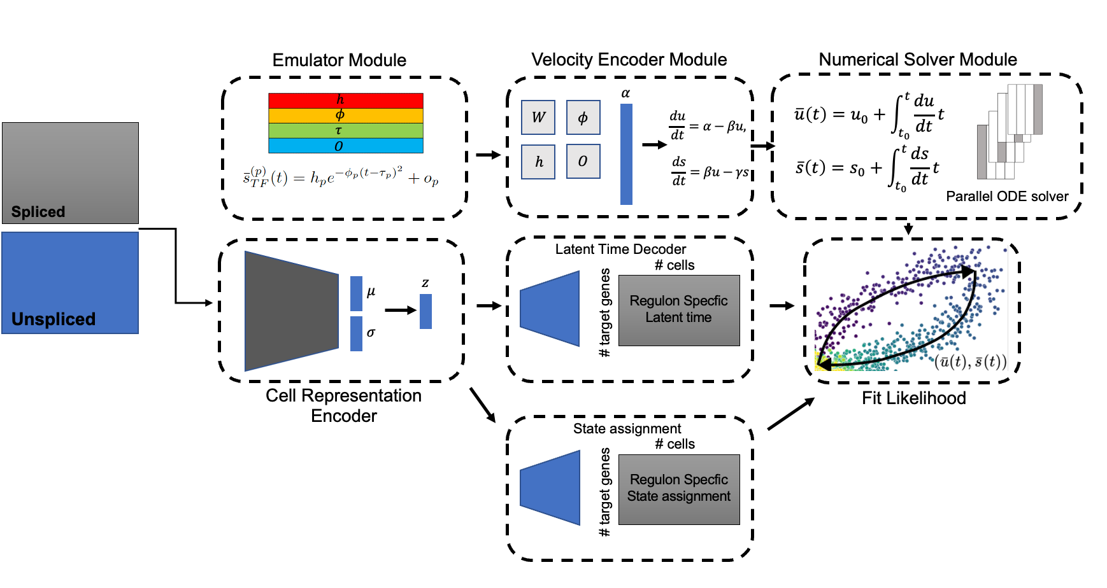
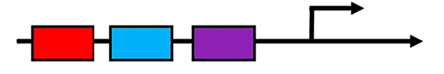
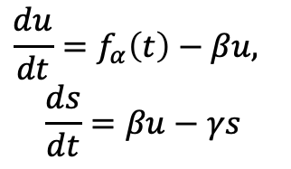

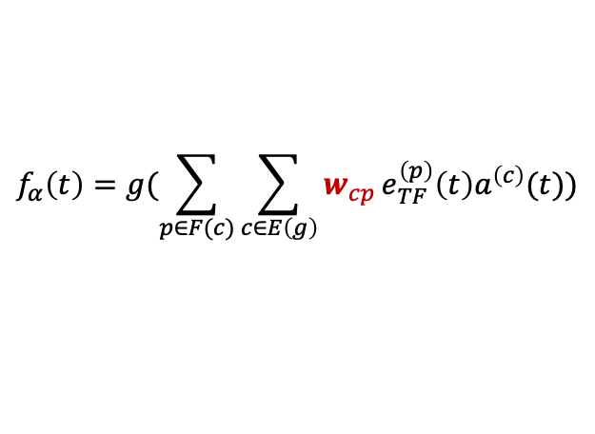


Current limits in RNA velocity
Potential application of RegVelo
1. A better velocity estimation and fate probability prediction
$$α$$
$$β$$
$$γ$$
2. Understanding the underlying regulatory mechanisms of lineage differentiation/priming
3. Generate new trajectory and test the effects of TF-perturbation the lineage differentiation.
Bergen, et al. 2021
Bergen, et al. 2022
1. Transcriptional bursting induced by change of
transcription rate
2. Each gene fit independently, ignoring everything about regulation relationship
Combine cis-regulation with RNA velocity
RegVelo, Multivariate Models towards systems dynamics
Supervised by: Marius & Fabian
$$\frac{du}{dt}=f_{α}\left(t\right)−βu,$$
$$\frac{ds}{dt}=βu−γs$$
TF2
TF1
CRE1
CRE2
CRE3
Target genes
$$f_{α}\left(t\right)=g(\sum_{p∈F(c)}{\sum_{c∈E\left(g\right)}{w_{cp}}e_{TF}^{\left(p\right)}\left(t\right)a^{\left(c\right)}(t))}$$
TF: Transcription Factor
CRE: cis-regulatory elements
Modeling the transcription rate of target gene through integrating TF expression, CRE accessibility and sequence features

Slide 2
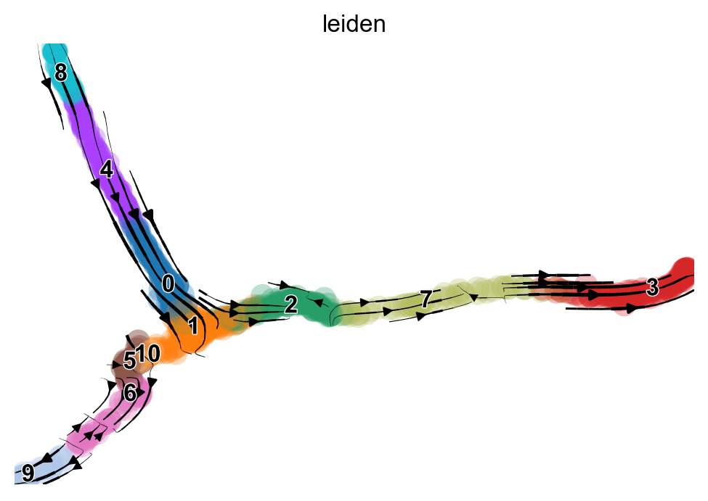
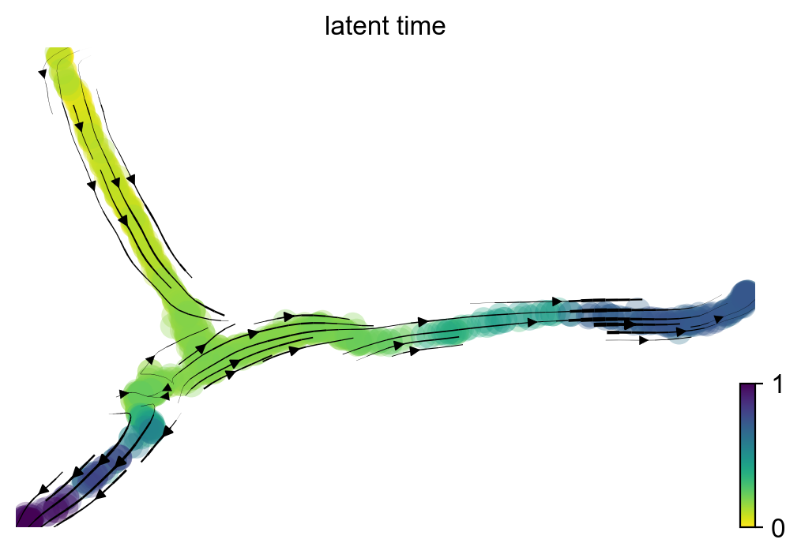
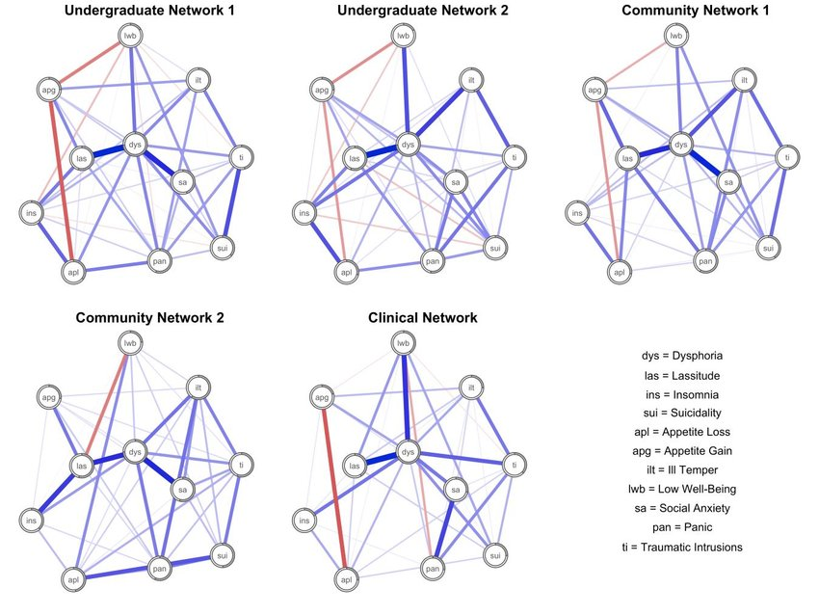
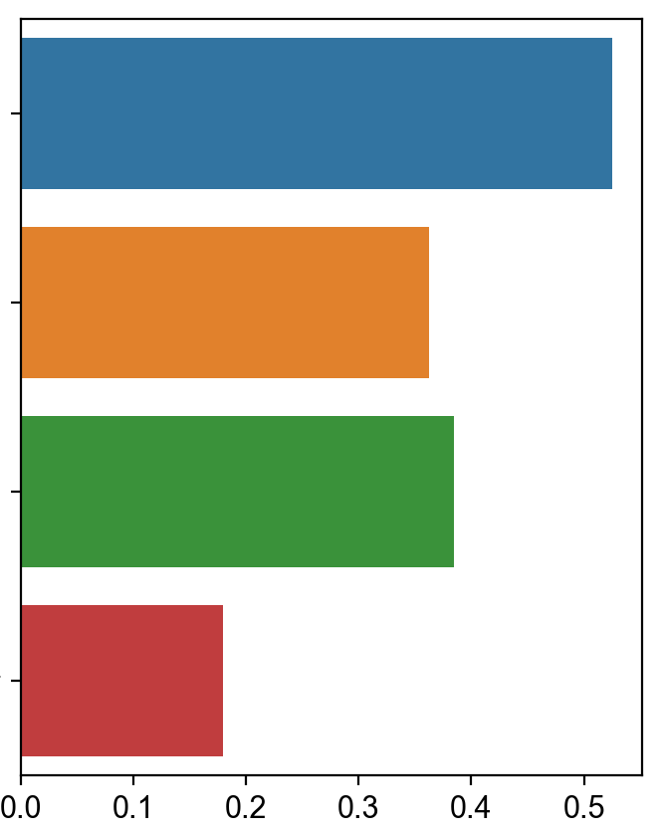

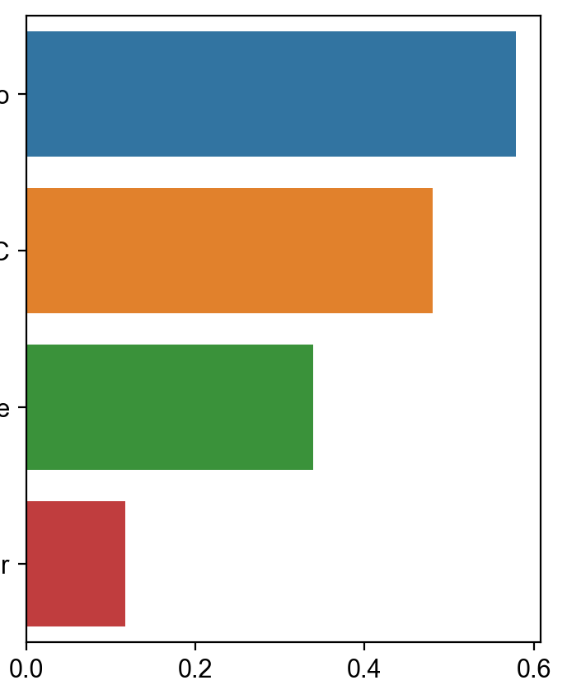
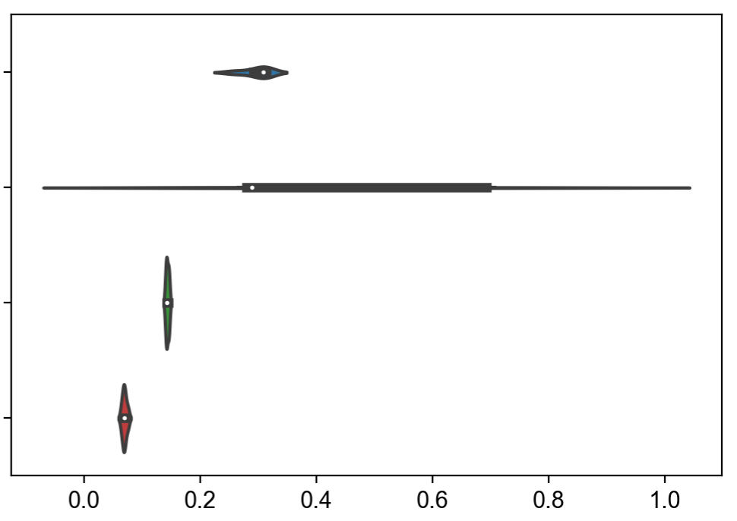
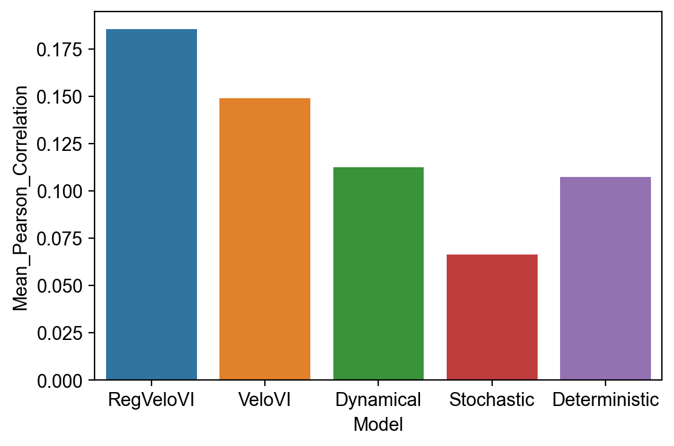
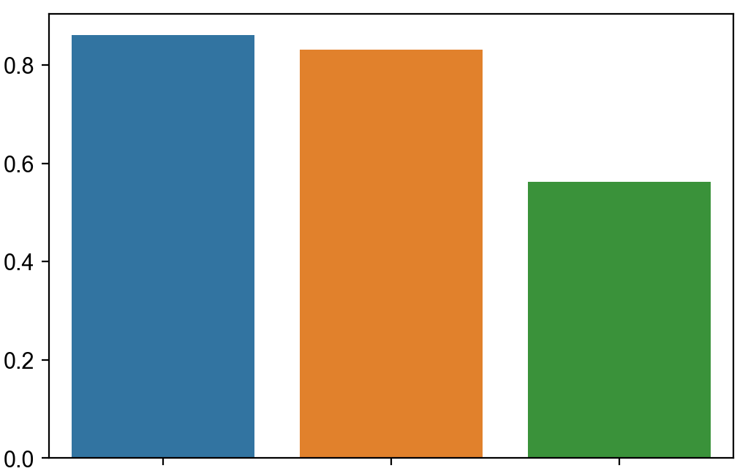
RegVelo gives better velocity estimation
RegVelo gives better regulation prediction
Ground truth
truth edges weights
Simulated Datasets
RegVelo predicted vector field
Predicted
Predicted edges weights
Regulatory edges weight predictive accuracy
5-fold CV
RegVelo
RegVelo
Decouple velocity Model
SCENIC
SCENIC
Shared time velocity Model
CellOracle
CellOracle
VeloVI
Pearsonr
Pearsonr
RegVeloVI
Spearman Correlation
Spearman Correlation
RMSE
Future direction
Correlation with ground truth velocity
Correlation with ground truth latent time
1. Incorporate scATAC-seq datasets to build full regulatory velocity model (TF -> CRE -> target)
2. Considering the sequence features in transcription rate prediction
Mean Pearson Correlation
Mean Spearman Correlation
3. Perturbed TFs to perform OOD prediction (perturbation prediction)
RegVelo
Dynam
ical
Stochastic
determ
inistic
VeloVI
RegVelo
VeloVI
Stochastic

